Slide 1



Slide 2

History of Foliar Micronutrients
Time Frame | Product Foliar Application | Features
1920s | Oxides | Insoluble in water; Poor absorption
1950s | Sulfates | Salts are not chelated or complexed; Phytotoxic because of deliquescence (accumulation of unabsorbed salt on leaf surface); High rates need to see results (better when soil applied); Incompatible with most pesticides
1960s | Phenolics | Derived from chlorides, low pH, high levels of impurities; May cause phototoxicity at higher air temperatures
1970s | Citrates | Weak chelate (complex); Incompatibility problems with may pesticides
1970s | Lignosulfonates | Very large molecular size; May contain large amounts of impurities
1970s | EDTA | Synthetic molecule alien to the plant; Not readily absorbed; Phytotoxic; Persistent organic pollutant; Does not easily release nutrient for the plant to use in important enzymatic processes
1970s | Polyphosphates | Large molecular size; Not in the plant available form; Need time and special condition to convert to plant available form. Not possible with all nutrients
1980s | Amino Acids | Source of amino acids mostly from animal origin; Plant origin amino acids very costly
1980s | Glucoheptonates | May contain ferric cyanide which is poisonous and may build up in plant tissue; often not chelated
2000s | Max Carbohydrates | Carbohydrate chelated nutrients
2004 | TruPhos (MOD) | Orthophosphate sequestered nutrients; Completely water soluble; Liquid formulations; Safe
2009 | PolyAldoCarbosate (PAC) | Specially selected carbohydrate chelated nutrients; Natural plant origin; Liquid formulations; Safe
2012 | TruPhos Max(orthophosphate+PAC) | Orthophosphate sequestered and PAC chelated nutrients; Completely water soluble; Liquid formulations: Safe
2012- To Date | ACE, EBN, EAC, BOS, M-BOS, PGE… | A far-reaching suite of technologies for every growth stage, for all type of crops.

Slide 3

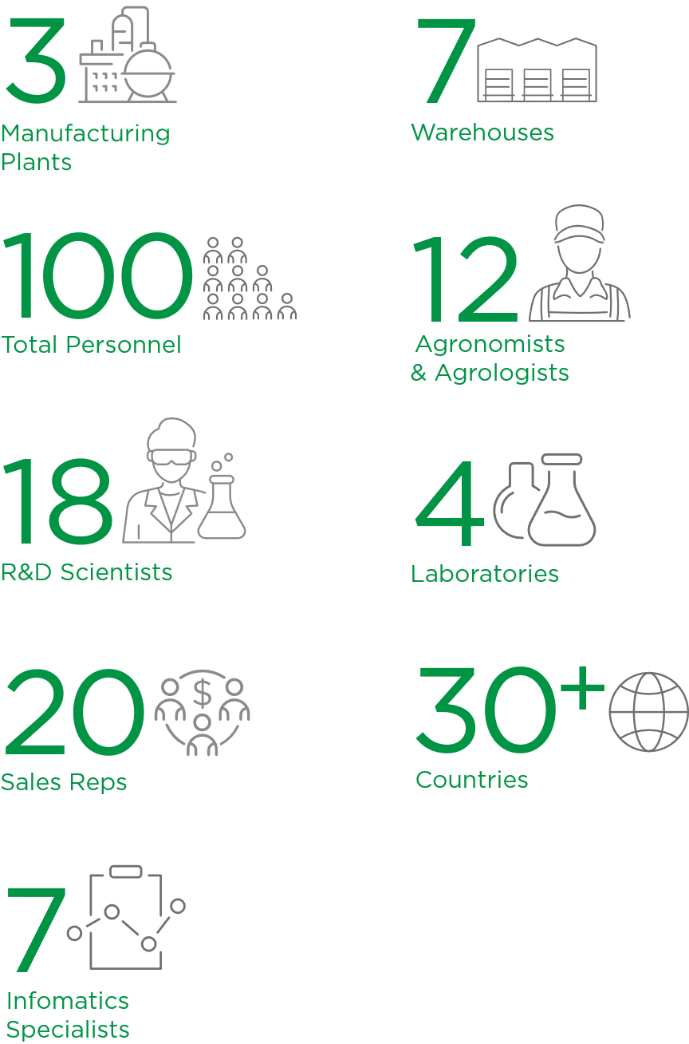
Our Growth
Milestones
Company Statistics
Our group was founded in 1963 in South Africa
Founded by world-renowned agronomist, Dr. Jonah Fisher.
International Distribution Network
30+ Countries
North American product development, manufacturing, distribution & embedded agronomic team
• 32 years in North America.
• 2000, Built production facility in Canada.
• 2013, Built US production facility in California.
• 2018, Built RootpHos plant in Biola
• 2018 – 2022, Expanded production capacity and warehousing.
Acquired adjacent land to double size of facility in California.
• 2021 – 2023, Acquired 4 acres of land, and built Manufacturing Facility,
and building new Head Office, Laboratories, and Distribution center in Toronto.

Slide 4
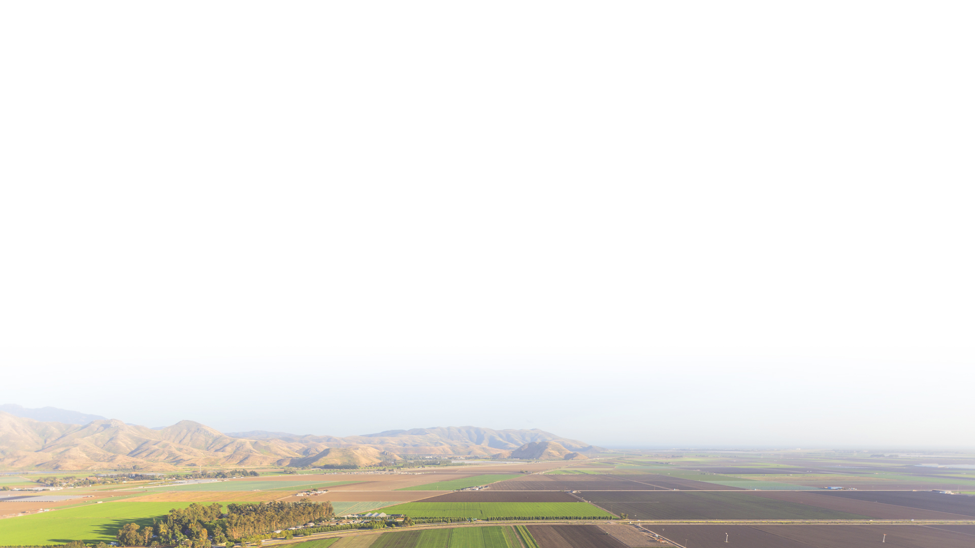






What Drives Us
Intensely Focused
on our customers
Cutting-Edge Science
is our passion
Obsessed
with production quality
Premium
Technology Provider
for specific field and
crop challenges
Agronomic Excellence
with best-in-class field
technical support and embedded agronomic teams in
strategic markets
Committed
to promoting sustainable agriculture by combining environmental protection, social responsibility,
and fairness meet the needs of future generations

Slide 5
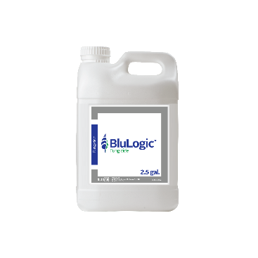
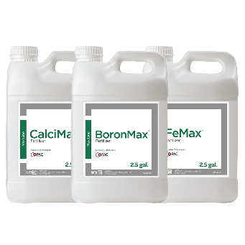
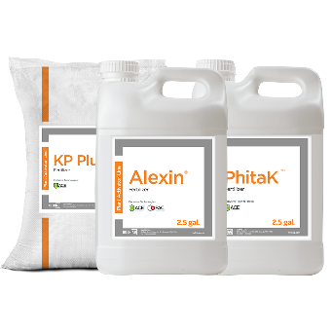
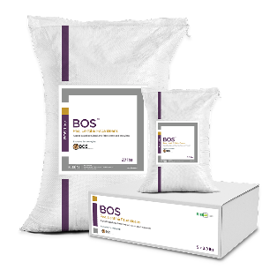
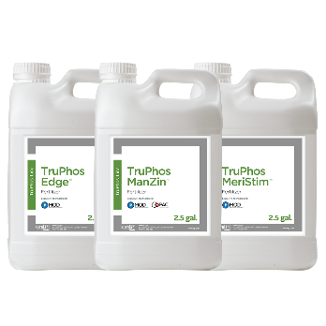
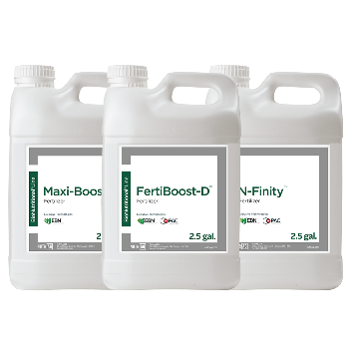
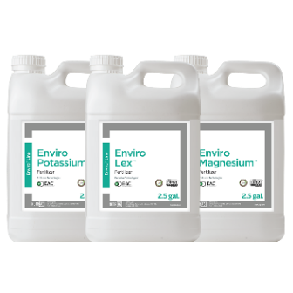
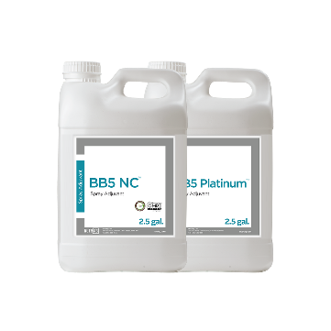
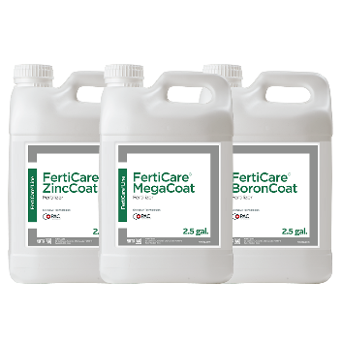
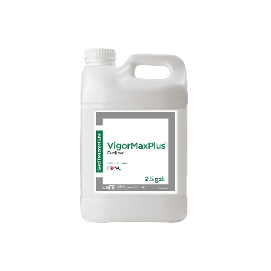
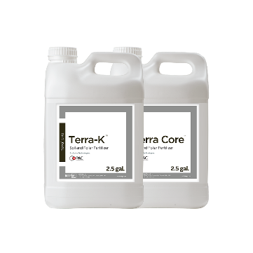

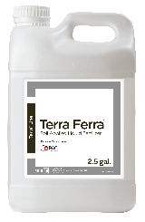
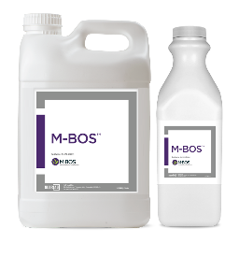
Our Brands
Research has shown
that 74% of customers expect more today from brands —
Not just around product performance, but in how brands treat their customers, employees, business partners, and the environment.
— Carlos Guerrero
Max™ Line
Essential Foliar Micronutrients
Plant Activator™ Line
Plant Health
BOS Line
Inoculants
BluLogic
Copper Fungicide
TruPhos® Line
100% Orthophosphate
BioNutritional™ Line
Biofortify Growth & Development
Enviro™ Line
Organic Essential Foliar
Micronutrients
Water Conditioners
Adjuvants and Water Conditioners
FertiCare™ Line
Liquid Nutrient Fertilizer Coating
VigorMax
Seed Treatment
Nutrient Seed Coating
Terra Line
Soil Applied Application
Microbial Line
Increase Stress Tolerance
and Growth Rates

Slide 6
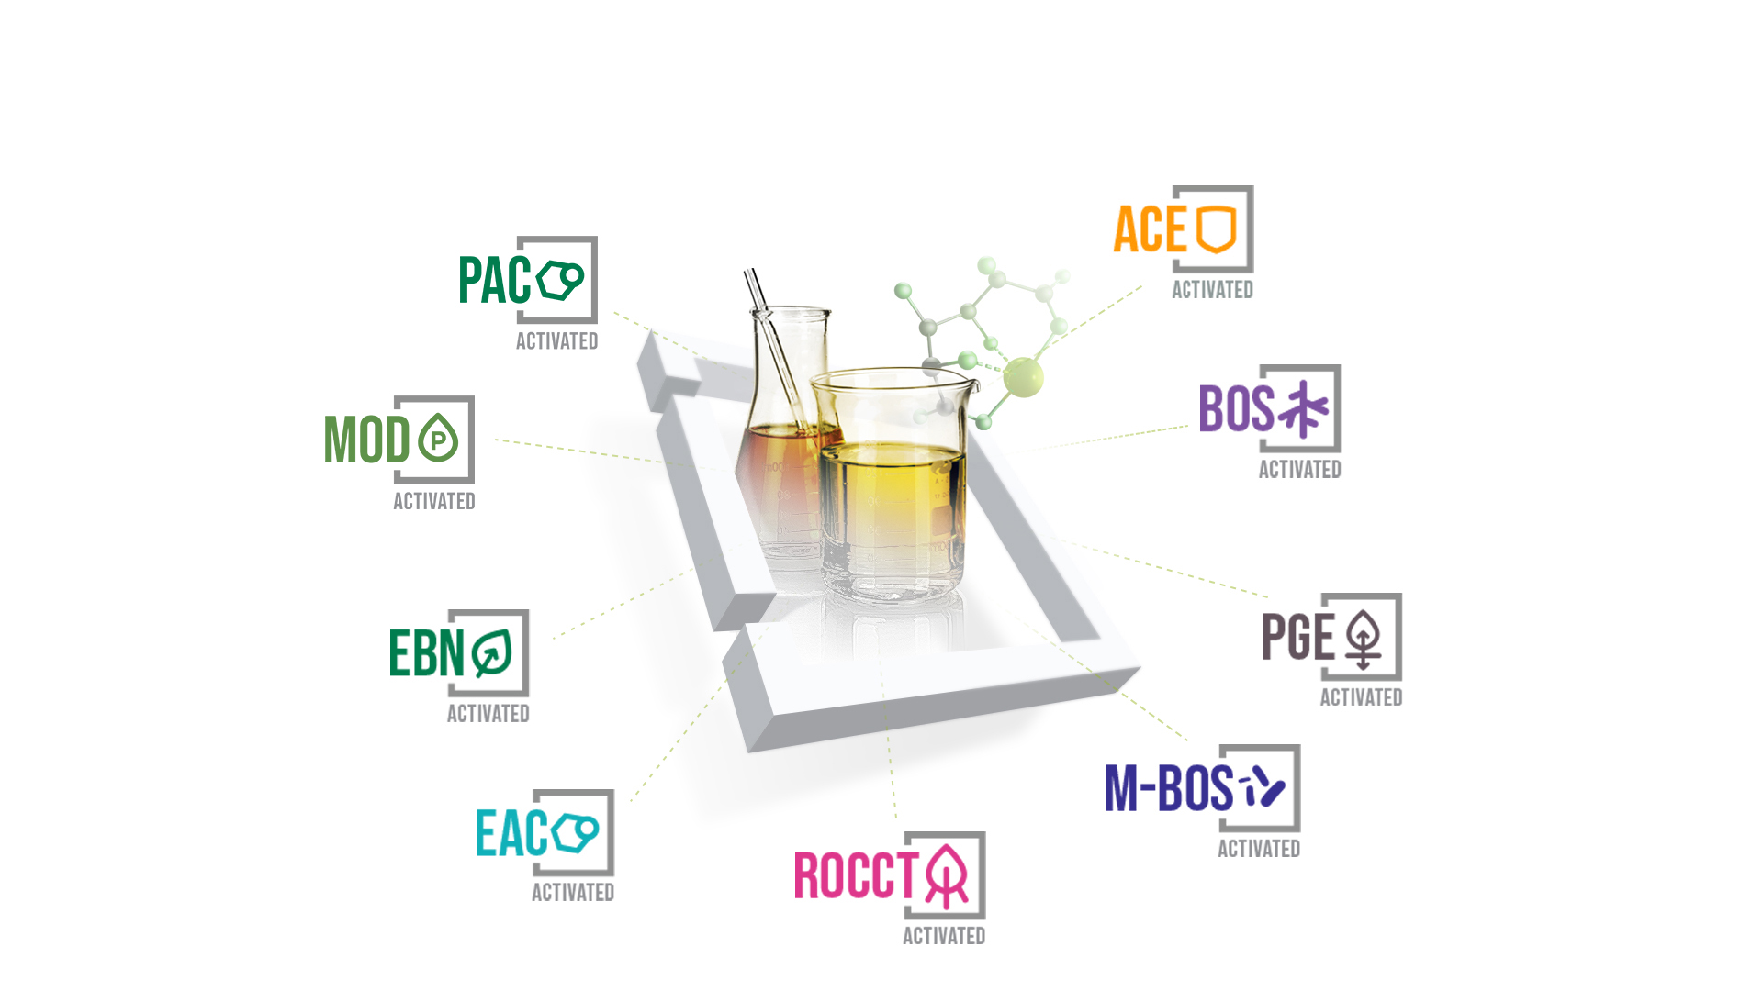
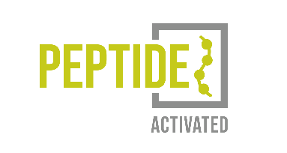
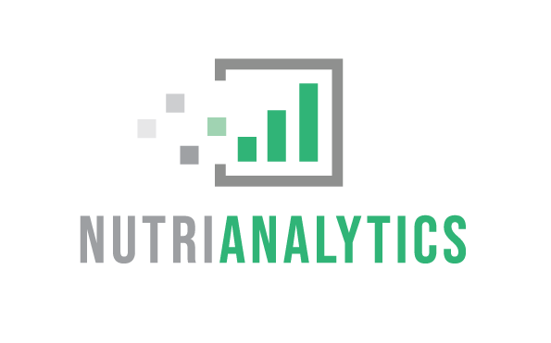

Our Technologies
Software as a Service
and Consulting

Slide 7
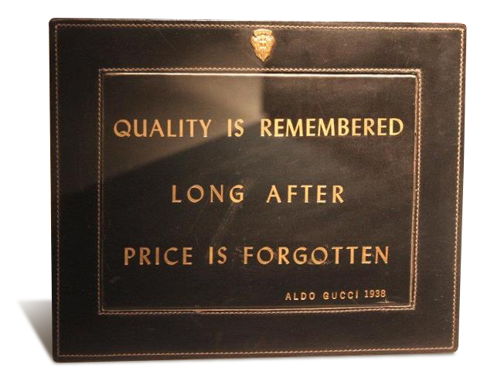
Plant Nutrition/Pesticide Industry
The bitterness of poor quality is remembered long after the sweetness of low price has faded from memory.
(Blocked nozzles, clean up costs, crop phytotoxicity, incompatibility, poor reputation, and respray costs.)

Slide 8
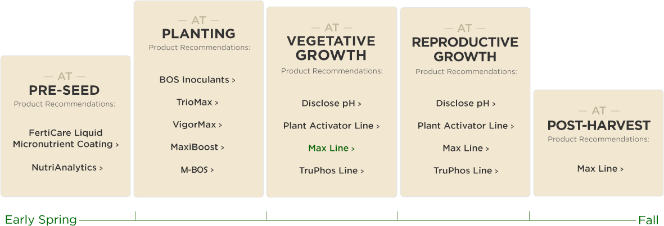
Our Product Reach
From pre-seeding through to harvest,
we have it covered.

Slide 9
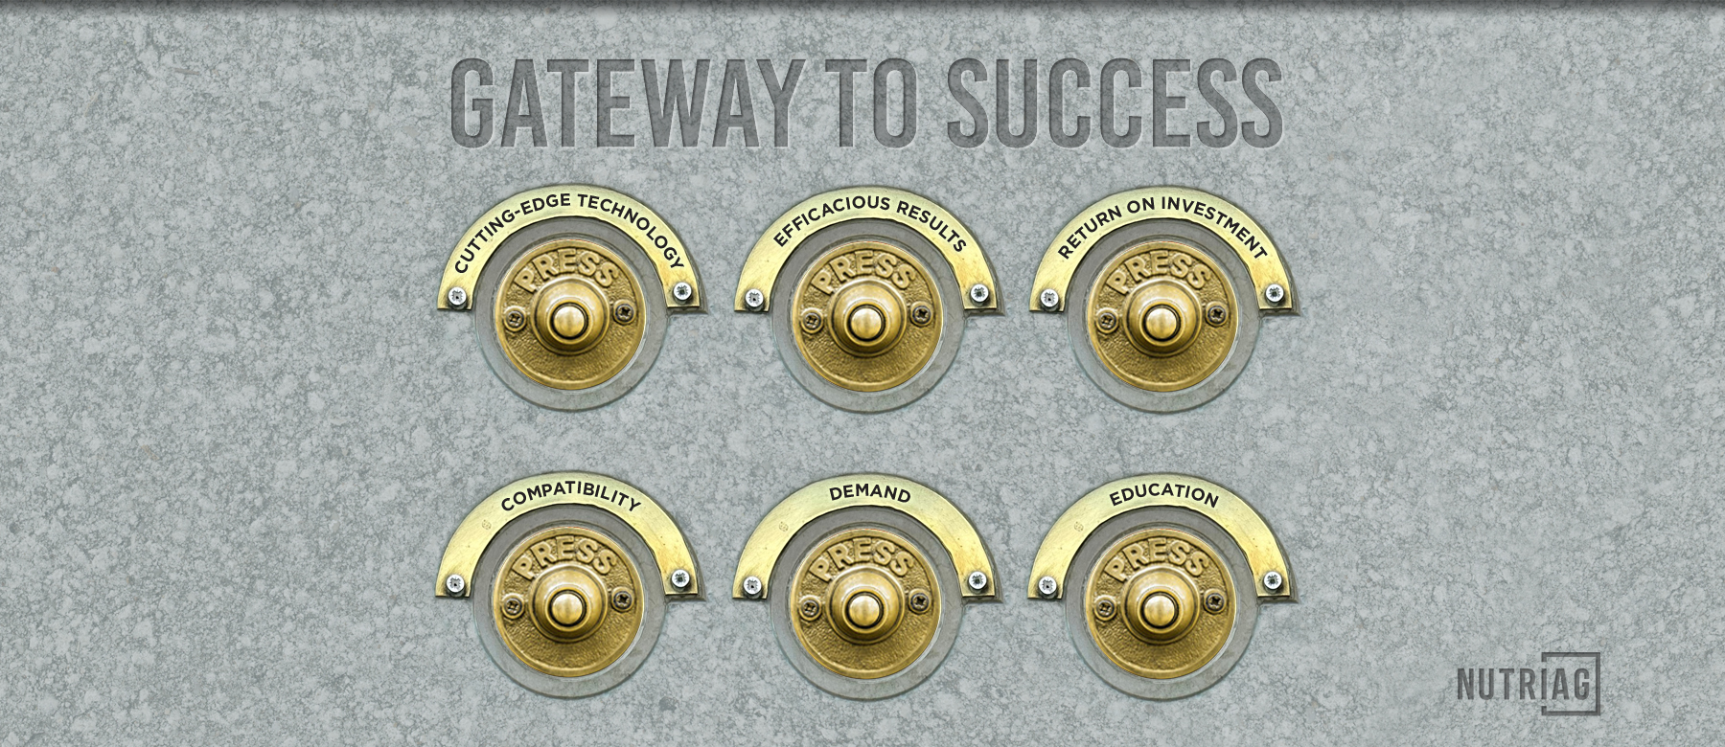

Slide 10
Thank you.

